Slide 1
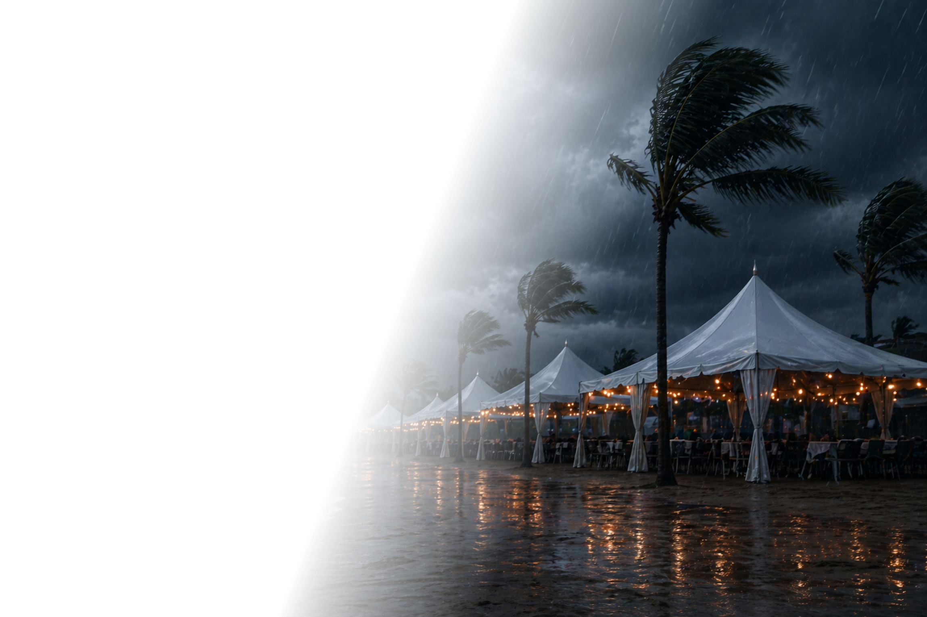

What’s Your Plan
When Weather Hits?
Hurricanes and unexpected rain can undo months of work in a single day

Slide 2
Traditional Insurance
Leaves Gaps
Focuses on physical damage, not lost revenue or attendance.
Claims can be slow, contested, and complex.
Deductibles and downtime still hit your cash flow.
There’s a better way
to plan for rain and hurricanes

Slide 3
Parametric Weather Coverage: Simple and Clear
You choose the weather trigger
(hurricane or rainfall amount).
Independent weather data measures what actually happens.
If the agreed trigger is met, coverage responds with a defined payout.
Funds are typically available in about
7 days (rain) or 30 days (hurricane).

Slide 4
Real Weather. Real Payouts.
The payout came through quickly and helped us move forward with confidence”
Clear triggers, fast payout, and exactly what we needed when it mattered most.”
It worked exactly as described. We received our payment in a week.”
Festival Organizer
Event Producer
Golf Tournament Director
Texas
Florida
South Carolina

Slide 5
Tailored to Hurricane and Rain Risk
Rain Coverage
Hurricane Coverage
Choose how much rain, when, and where it matters.
Choose coverage option: 30 miles from location or 30 & 60 miles.
If recorded rainfall meets that level in the agreed time window, a pre-defined payment is made.
If the recorded storm track crosses into your coverage area, a pre-defined payment is made.

Slide 6
The Math Can Make Sense
Rain Example
$50,000
Hurricane Example
  Outdoor event with $50,000 at-risk revenue
  Trigger: 0.25" of rain or more during event hours
  If that happens, coverage responds with a $20,000 payment
Recorded Category 3 storm track within 30 miles
at risk revenue
$20,000*
$35,000*
coverage payment
coverage payment
*limits and payouts are fully customizable
*limits and payouts are fully
customizable

Slide 7
Why Clients Choose Vortex
7 day (rain) / 30 day (hurricane)
payouts
Clear triggers and
defined payments
Payouts based on independent weather data
A+ rated carrier

Slide 8
Add a Simple Weather Plan
Before the Next Storm
Identify the rain or hurricane exposures that matter most.
Choose clear weather triggers and payment amounts.
See example pricing so you can decide what level of protection feels right.
Talk to me if you’d like to see a simple example for your event or location.

Slide 9

What’s Your Plan
When Weather Hits?
Hurricanes and heavy rain can undo months of work in a single day

Slide 10
Traditional Insurance
Leaves Gaps
Focuses on physical damage, not lost revenue or attendance.
Claims can be slow, contested, and complex.
Deductibles and downtime still hit your cash flow.
There’s a better way
to plan for rain and hurricanes

Slide 11
Parametric Weather Coverage: Simple and Clear
You choose the weather trigger
(hurricane or rainfall amount).
Independent weather data measures what actually happens.
If the agreed trigger is met, coverage responds with a defined payout.
Funds are typically available in about
7 days (rain) or 30 days (hurricane).

Slide 12
Real Weather. Real Payouts.
The payout came through quickly and helped us move forward with confidence”
Clear triggers, fast payout, and exactly what we needed when it mattered most.”
It worked exactly as described. We received our payment in a week.”
Festival Organizer
Event Producer
Golf Tournament Director
Texas
Florida
South Carolina

Slide 13
Tailored to Hurricane and Rain Risk
Rain Coverage
Hurricane Coverage
Choose how much rain, when, and where it matters.
Choose coverage option: 30 miles from location or 30 & 60 miles.
If recorded rainfall meets that level in the agreed time window, a pre-defined payment is made.
If the recorded storm track crosses into your coverage area, a pre-defined payment is made.

Slide 14
The Math Can Make Sense
Rain Example
$50,000
Hurricane Example
  Outdoor event with $50,000 at-risk revenue
  Trigger: 0.25" of rain or more during event hours
  If that happens, coverage responds with a $20,000 payment
Recorded Category 3 storm track within 30 miles
at risk revenue
$20,000
$35,000*
coverage payment
coverage payment
*limits and payouts are fully customizable
*limits and payouts are fully
customizable

Slide 15
Why Clients Choose Vortex
7 day (rain) / 30 day (hurricane)
payouts
Clear triggers and
defined payments
Payouts based on independent weather data
A+ rated carriers

Slide 16
Add a Simple Weather Plan
Before the Next Storm
Identify the rain or hurricane exposures that matter most.
Choose clear weather triggers and payment amounts.
See example pricing so you can decide what level of protection feels right.
Talk to me if you’d like to see a simple example for your event or location.

